Slide 1
Audit Management
Project TITLE

Slide 2
Audit management
POD MENTOR | NAGARAJAN SANJEEVIRAJAN
TRAINER | GAYATHRI MAHADEVAN
POD LEADER | UJWAL N M
POD MEMBERS | MARIA ANTONY A SAKUNTHALA PL VIJAY K PATIL

Slide 3
ACKNOWLEDGEMENT
We express our deepest sense of gratitude towards our respected and noble mentor Nagarajan Sanjeevirajan and our trainer Gayathri Mahadevan for spending their valuable time on several occasions to impart us the gains of their knowledge. It was our privilege to have worked under their guidance.

Slide 4
INTRODUCTION
Audits are an important and essential part of managing risk and control effectiveness within an organization.
Audit Management is an important tool for the continuous evaluation of the methods and performance of an enterprise. The prime objective of Audit Management is to locate defects of irregularities in the areas covered by the audit and to suggest remedial action.
In this project, we are going to automate the Audit Management Processing for an Organization using ASP. Net Core and ASP.NET Core Web API and also we are going to maintain the solid principles and design principles in our project solution.

Slide 5
Module segregation
1. Audit CheckList Module – Vijay K Patil
2. Audit Benchmark Module – Sakunthala PL
3. Audit Severity Module – Maria Antony A
4. Authorization Service – Ujwal N M
5. Audit Management Portal – Ujwal N M

Slide 6
Module description
1.AUDIT CHECKLIST MODULE :
This Module Provides a list of YES/NO type of questions for the audit based on the audit type and this will be consumed by the User interface that displays the questions on the portal.
2.AUDIT BENCHMARK MODULE :
This Module Provides the acceptable number of answers with NO as the answer for various audit types.

Slide 7
3.AUDIT SEVERITY MODULE :
This module gets the audit response and analyzes the project execution status by getting the Audit benchmark detail from Microservice, compares the current project data and determines the project execution status and the duration in which remedial action should be taken.
4.AUTHORIZATION SERVICE :
This microservice authenticates the user into the portal . Upon authenticating, this microservice also generates a JSON Web Token.
5.AUDIT MANAGEMENT PORTAL :
This Portal allows a member to Login, Choose audit type and view audit questions , Provide response and view the project execution status and Store the Audit date, Audit type, project execution status and remediation duration.

Slide 8
System Requirements

Slide 9
Hardware Requirements:
Laptop/Desktop with 8Gb RAM minimum
Programming Language used:
C# along with .NET Core Framework
Tools Used:
Visual Studio 2019
Azure : To host the micro services on server
Postman : To test the micro services API
SQL Server : To store the result into database

Slide 10
UI SCREENSHOTS

Slide 11
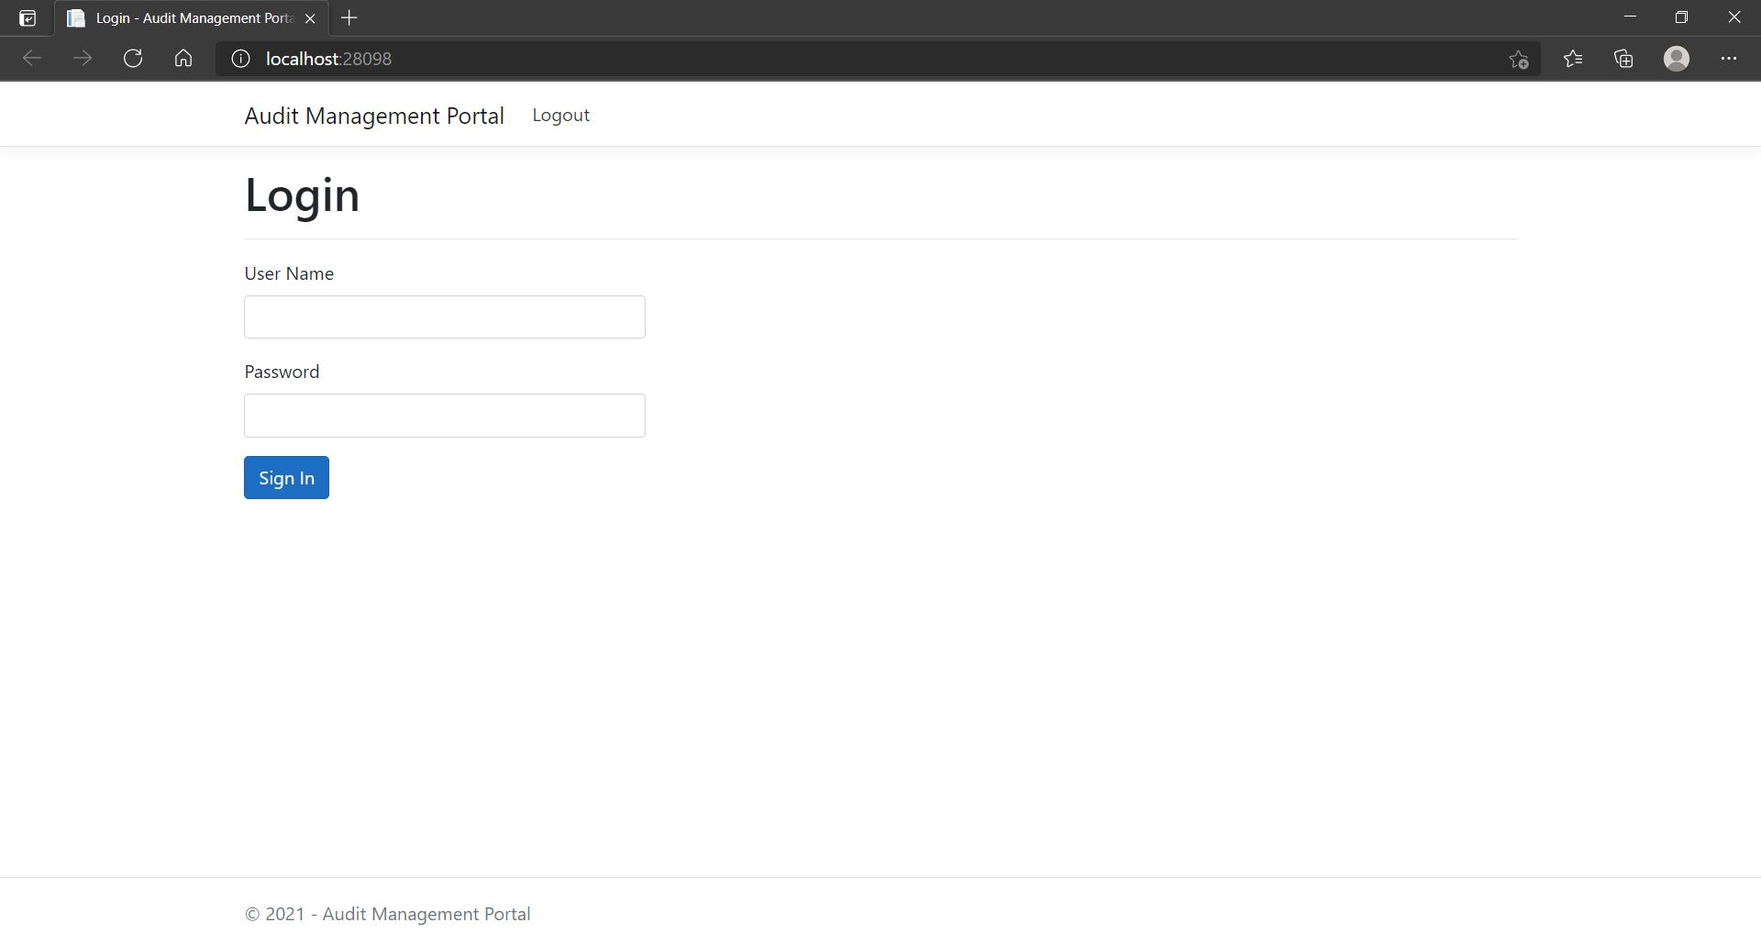

Slide 12
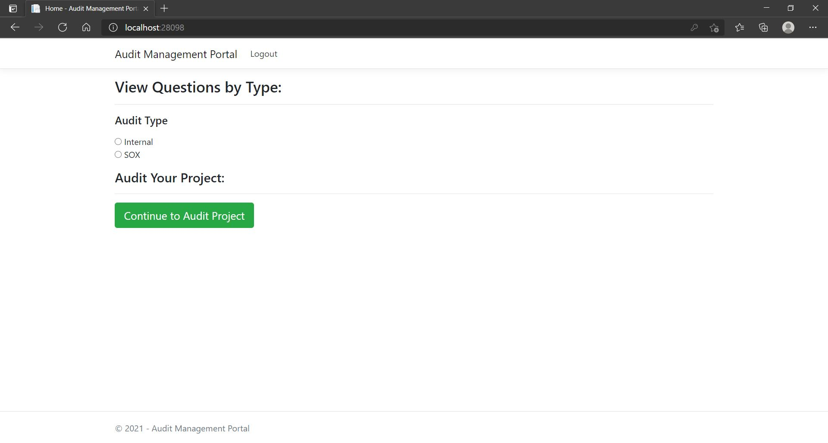

Slide 13
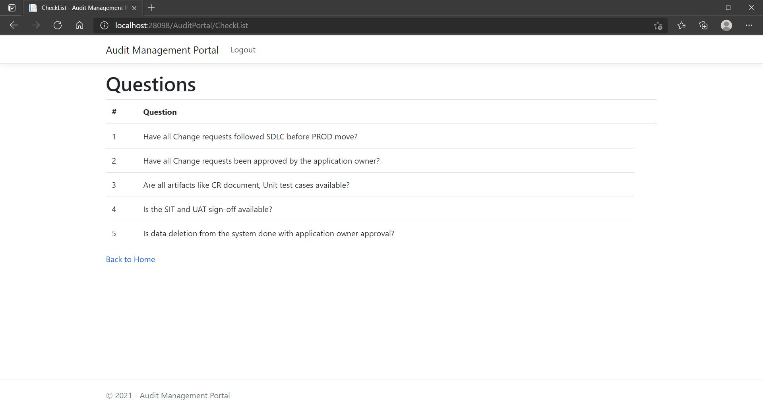

Slide 14
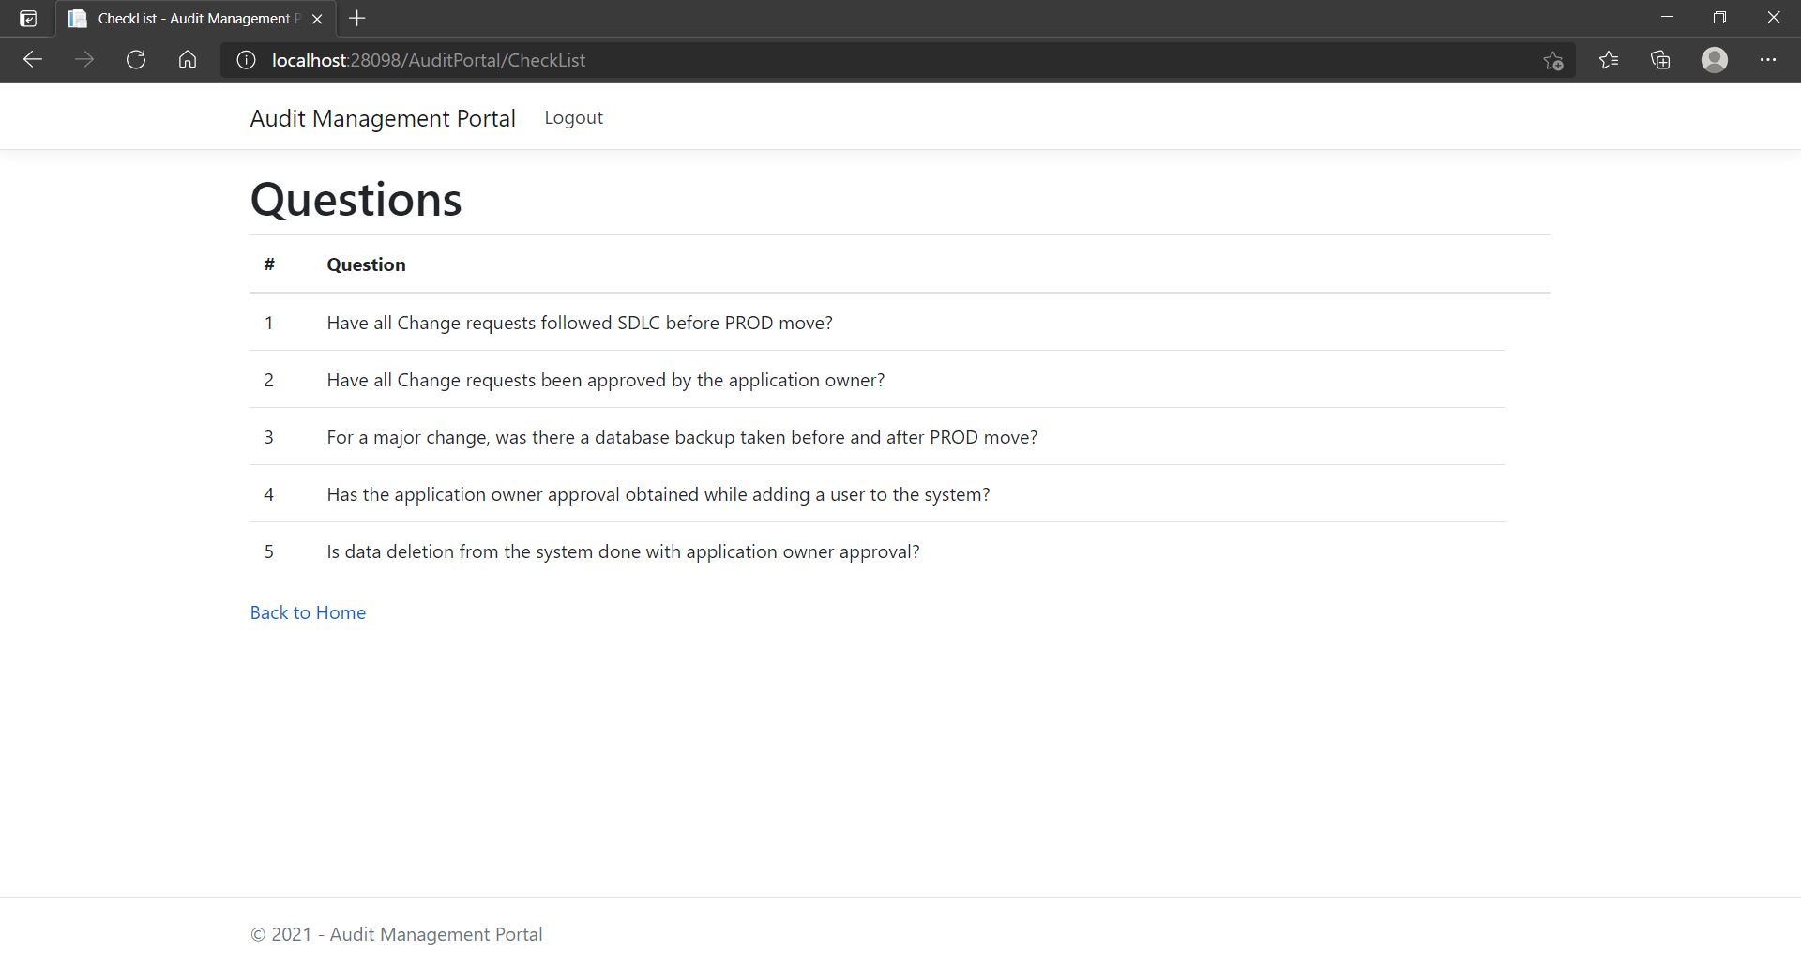

Slide 15
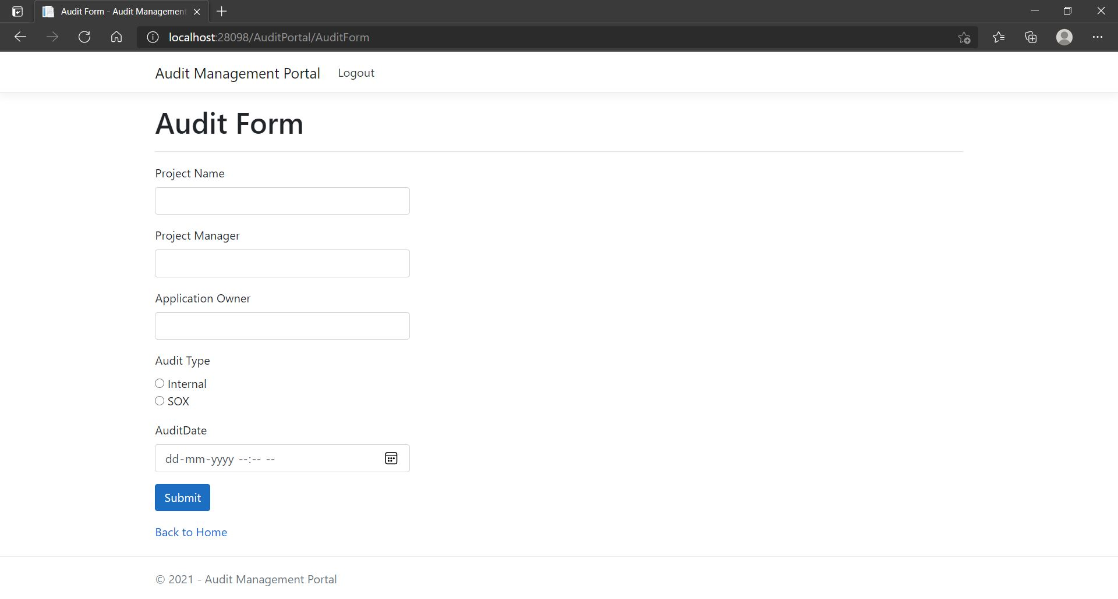

Slide 16
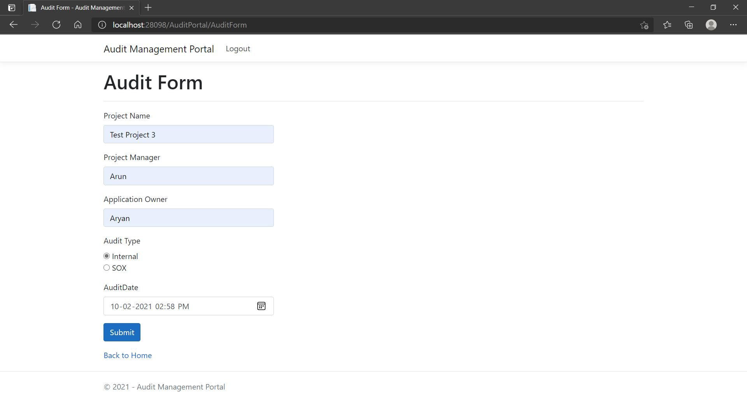

Slide 17
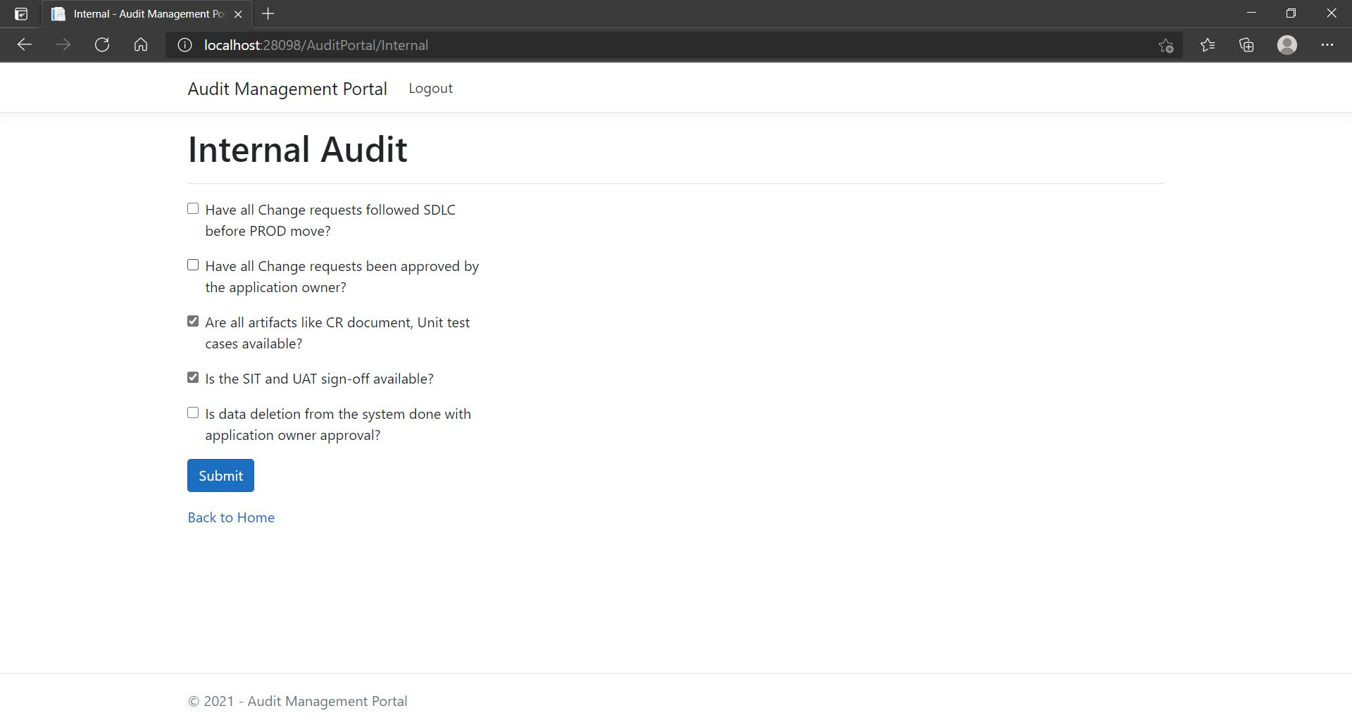

Slide 18
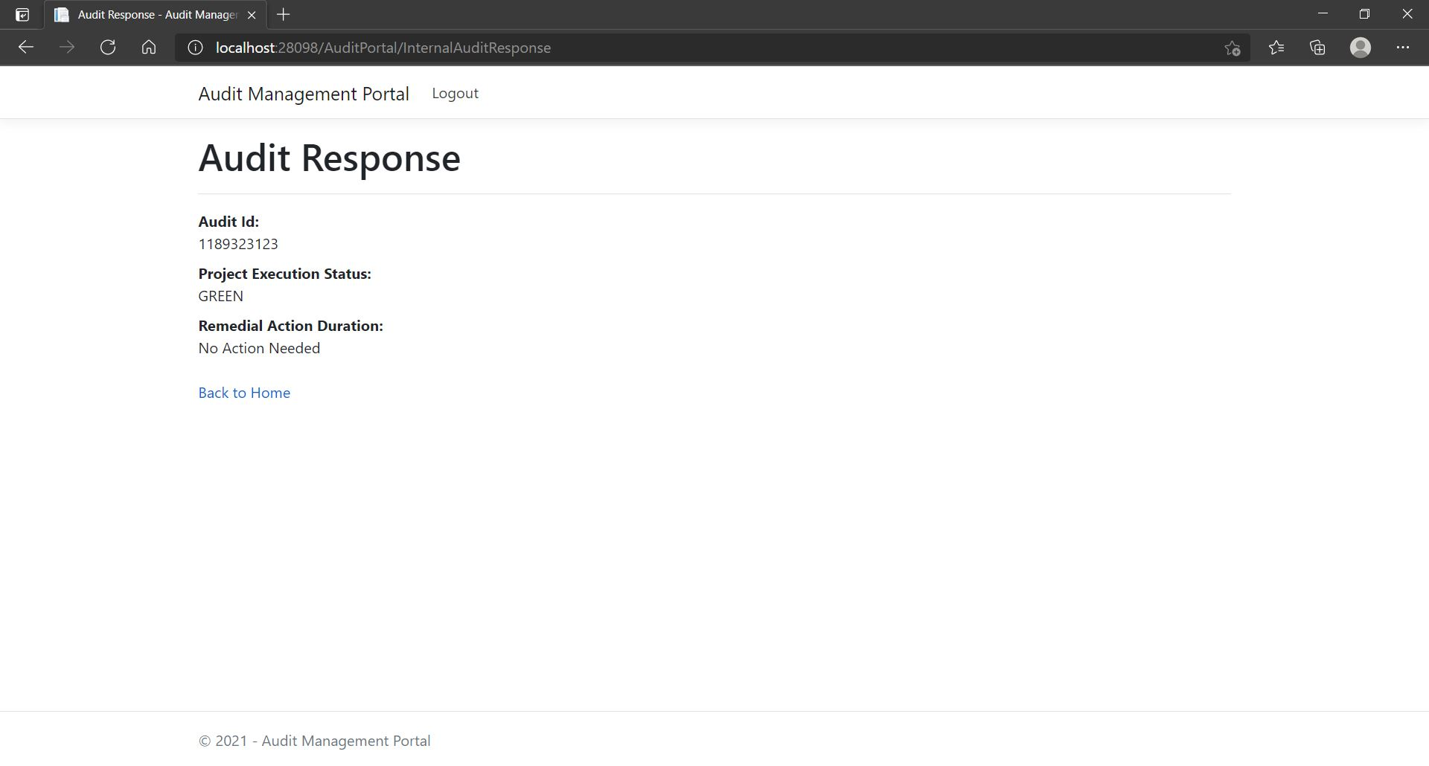

Slide 19


Slide 20
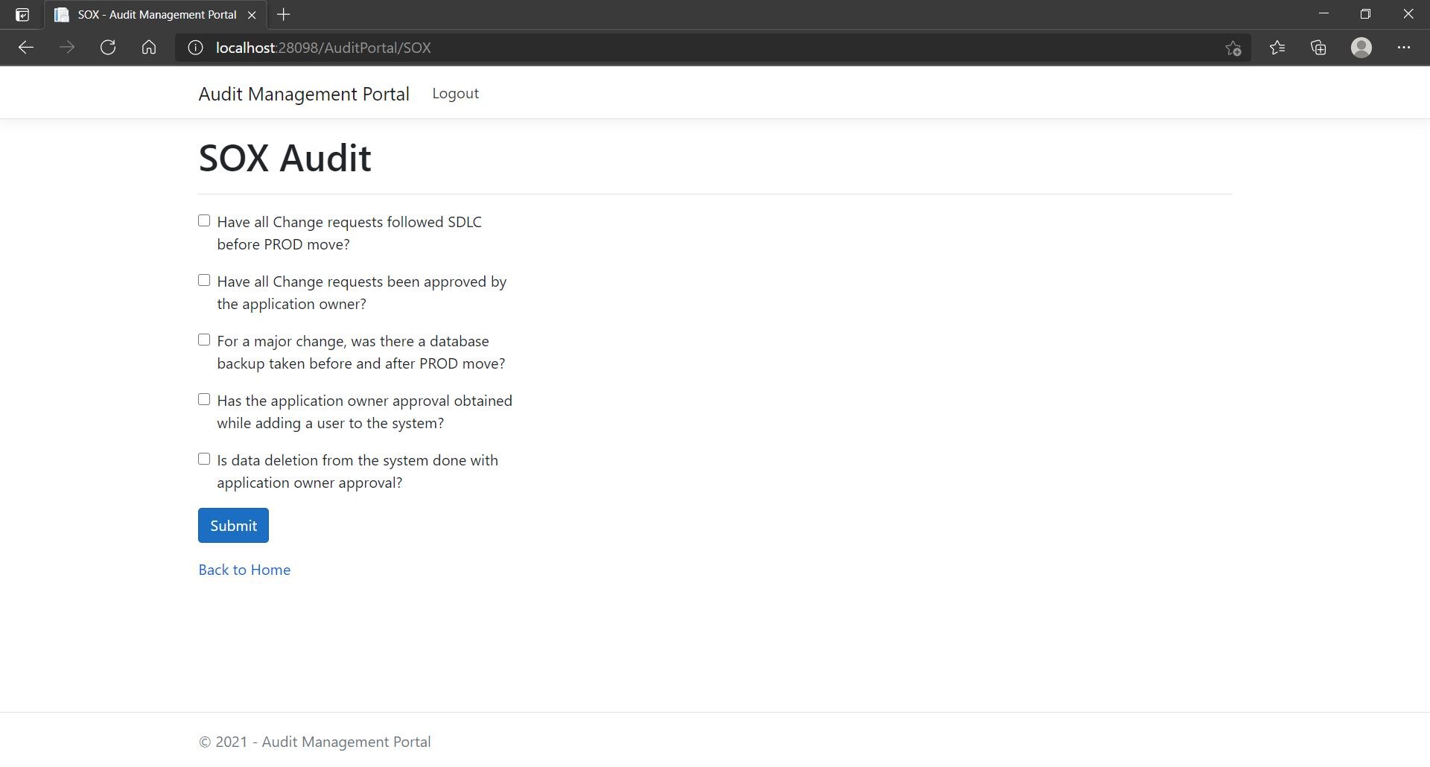

Slide 21


Slide 22
DePLOYMENT SCREENSHOTS

Slide 23
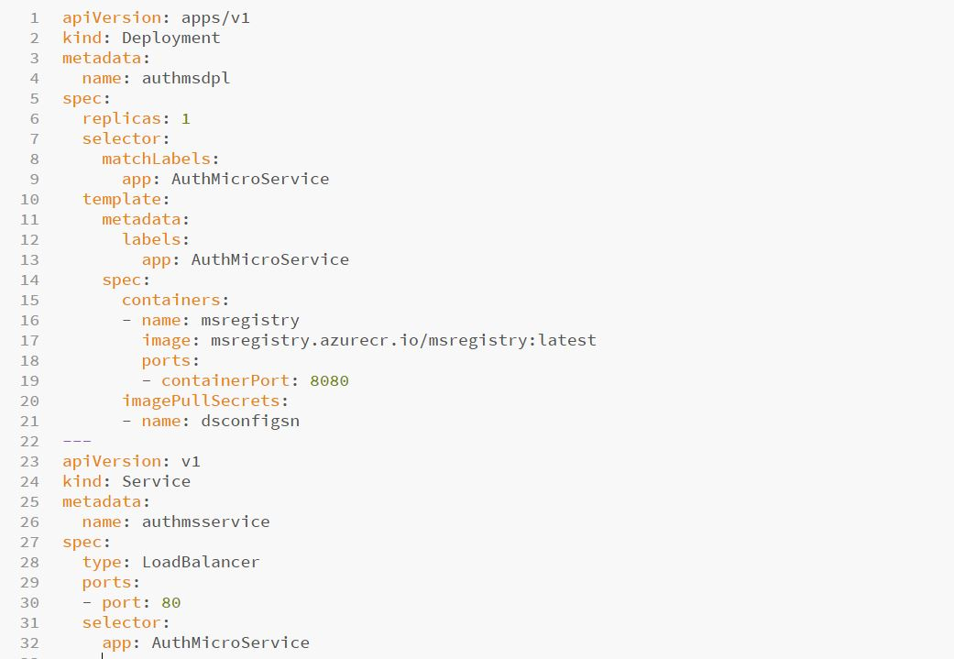

Slide 24
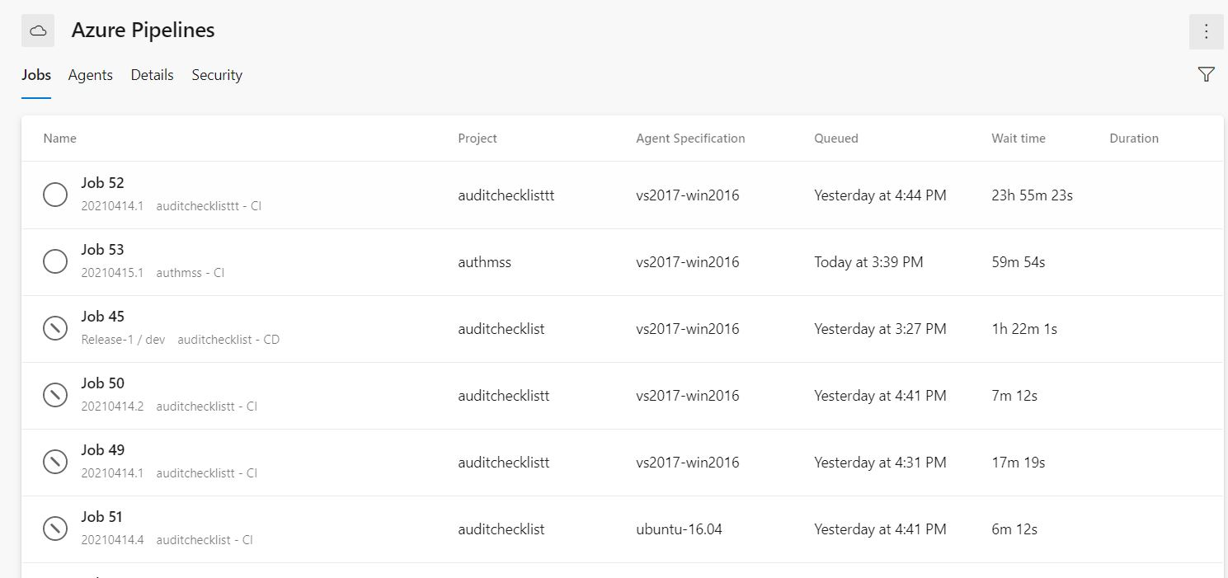

Slide 25
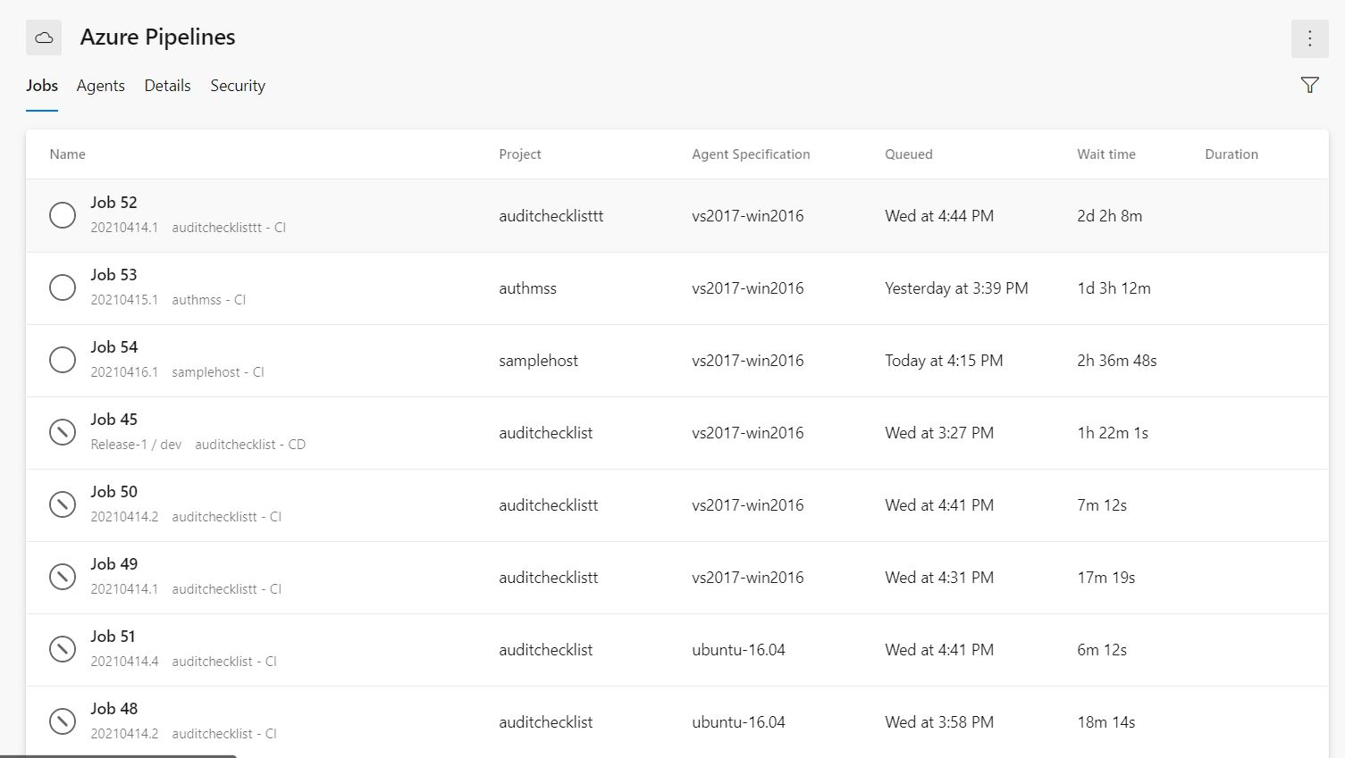

Slide 26
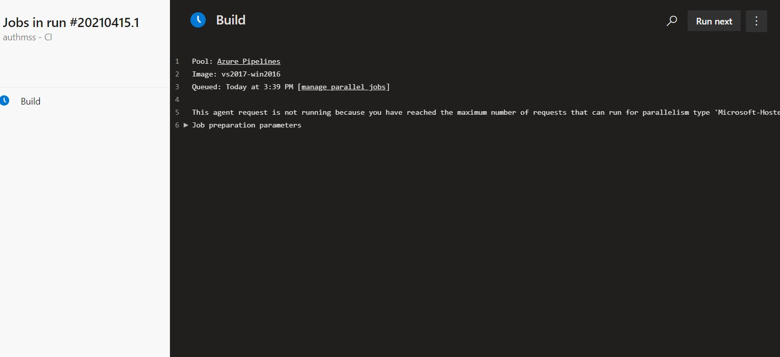

Slide 27
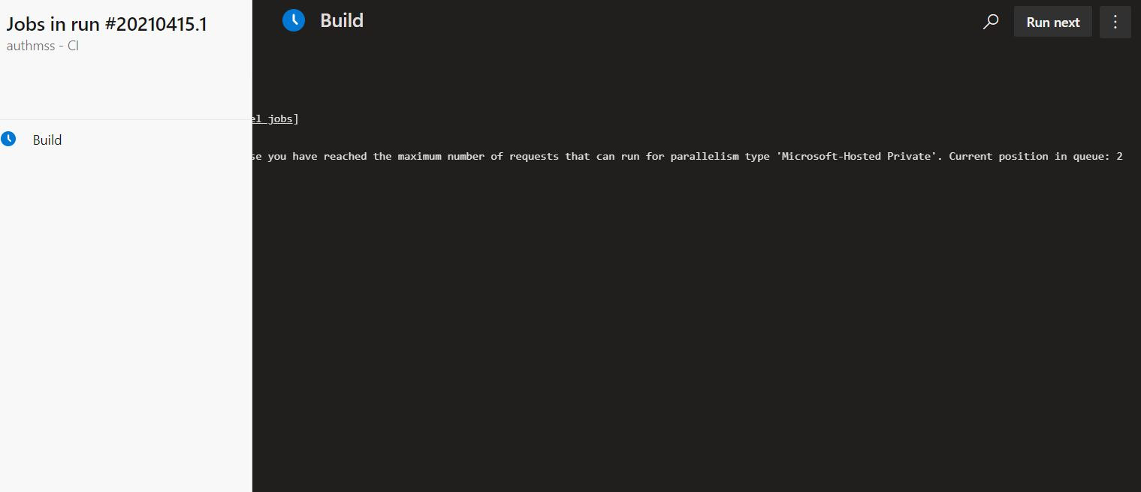

Slide 28
What We Have learned as a Team
We learned how to segregate the work within the team and collaborated among the team.
By working as a team we learned how to communicate effectively.
We motivated each other and learned how to be more productive.

Slide 29
What we have learned as an individual
MARIA ANTONY A
I have learnt about how to approach the people who are working in the same team to implement the ideas with good understanding.
I have learnt about how to help others when they are stuck with bugs and how to seek help when I am getting stuck.
I have learnt about how to give our contribution in a effective way.

Slide 30
Sakunthala PL
I have learned how to work together with a team to achieve a common goal.
I have learned how to exchange knowledge and skills.
I have learned how to be respectful of everyone’s input through communication.

Slide 31
VIJAY K PATIL
I learned how to deal with problems and challenges we faced while doing the project.
We can help each other when we have doubts.
Every team member will have different kind of skill set and those different skills we can know at different times.

Slide 32
UJWAL N M
The problem can be solved not only in one way but many ways.
Team work gives different perspectives to understand a given problem.
Team works makes problem solving easy as the whole problem is divided into sub problems such that its easy to solve small problem.

Slide 33
What could have been done better in this project as a team
Beyond the scope of the given problem description, we could have done better on the front end using bootstrap libraries.

Slide 34
What could have been done better in this project as a INDiVIDUAL
SAKUNTHALA PL
I could have planned better and completed my work even earlier.
I could have communicated even better with the team .
I could have completed the documents in parallel with the coding so it could have been easier

Slide 35
VIJAY K PATIL
I have learned how UML diagrams reduce the Work in later stages.
Learned how to manage the complex task by dividing it into different parts or steps.
Learned how to Plan and manage time.

Slide 36
MARIA ANTONY A
I could have been managed the time little more effectively.
I could have been helped others those who were all encountering the errors.
I could have been communicated with team little more.

Slide 37
UJWAL N M
Better time management for each of the tasks.
Taking right decisions on right time.
Better communication with the team.

Slide 38
CONCLUSION
In this project, We have implemented the Audit Management Processing using Design and SOLID Principles by segregating the functionalities into separate micro services.
It also improved our insight into Micro services, C# concepts, EF core, coding guidelines and Naming Conventions, WebAPI, MVC Core and NUnit Testing and Logging.

Slide 39
THANK YOU

